Slide 1
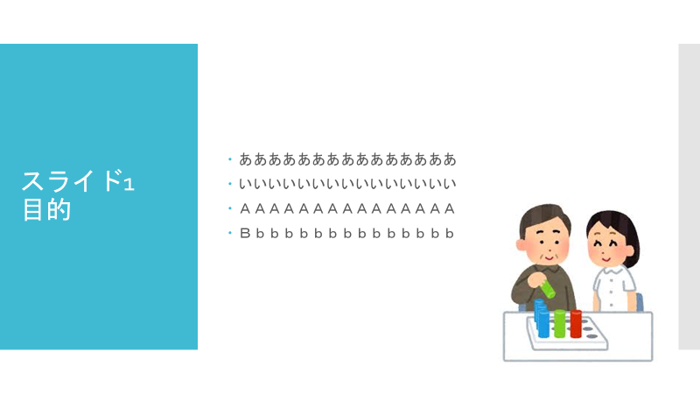
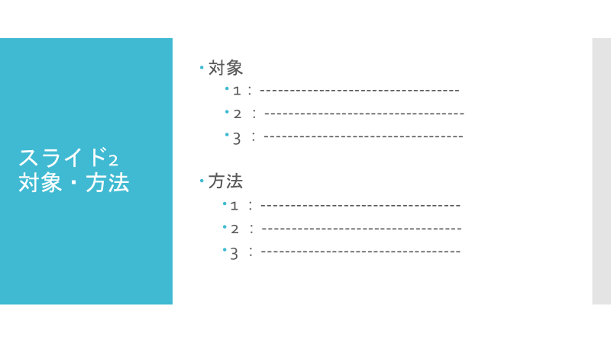
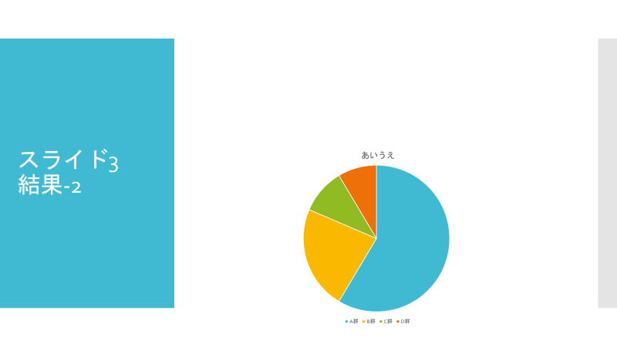
Title Affiliation
Name
Please include a written statement
regarding COI in the presentation.
The 57th Japanese Occupational Therapy Congress & Expo in Okinawa 2023 COI Disclosure Name of Author： xxx xxx
Companies, etc. in a relation of conflict of interest requiring disclosure by the lead presenter or co-presenter(s) in relation to the presentation:
Advisor: No
Stock ownership/capital gain: No
Patent royalties: No
Lecture fees: No
Manuscript fees: No
Budgets for contract research/joint research: Company xx
Scholarship donation: Company xx
Endowed chair: Company xx
Other remuneration such as gifts : No
The 57th Japanese Occupational Therapy Congress & Expo in Okinawa 2023 COI Disclosure Name of Author： xxx xxx There are no companies, etc. in a relation of conflict of interest requiring disclosure by the presenter(s) in relation to the contents of the presentation.

